Slide 1
Agenda
Life Cycle Hooks
Forms
Angular Material
Services & Dependency Injection
Http, Observables, RxJs
Routing & Navigation
Binding
Routing & Navigation
Security
State
Unit Testing
Deployment

Slide 2
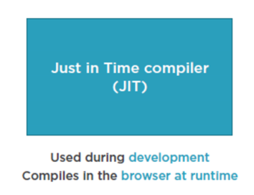
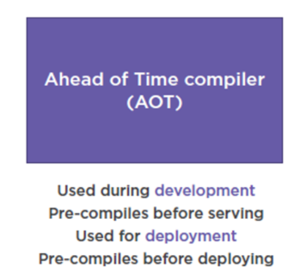
Compilation

Slide 3
Templates, Interpolation, and Directives
Interpolation
One way binding
From component class property to an element property.
Defined with double curly braces
- Contains a template expression
- No quote needed
Directive (
Structural Directives
*ngIf: If logic
*ngFor: For loops

Slide 4
Templates, Interpolation, and Directives
Interpolation
<h1>{{pageTitle}}</h1>
{{'Title: ' + pageTitle}}
{{2*20+1}}
Directive -
Custom HTML element or attribute used to power up and extend our HTML.
Custom
Built-In

Slide 5
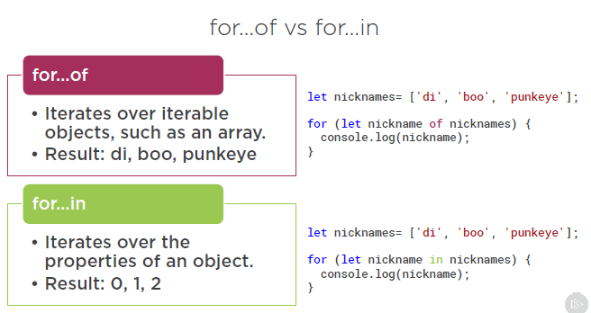
Directives
NgFor
- Show template variable
*ngFor='let product of products'>

Slide 6
Binding & Pipes
Binding
Coordinates communication between the component's class and its template and often involves passing data.
Pipes
Transforming Data
Pipe Examples
{{ product.productCode | lowercase }}
<img [src]='product.imageUrl'
[title]='product.productName | uppercase'>
{{ product.price | currency | lowercase }}
{{ product.price | currency:'USD':'symbol':'1.2-2' }}

Slide 7
Life Cycle Hooks
constructor
This is invoked when Angular creates a component or directive by calling new on the class.
ngOnChanges
Invoked every time there is a change in one of th input properties of the component.
ngOnInit
Invoked when given component has been initialized. This hook is only called once after the first ngOnChanges
ngDoCheck
Invoked when the change detector of the given component is invoked. It allows us to implement our own change detection algorithm for the given component.
ngOnDestroy
This method will be invoked just before Angular destroys the component. Use this hook to unsubscribe observables and detach event handlers to avoid memory leaks.
Hooks for the Component’s Children
These hooks are only called for components and not directives.
Note
We will cover the difference between Components and Directives in the next section.
ngAfterContentInit
Invoked after Angular performs any content projection into the component’s view (see the previous lecture on Content Projection for more info).
ngAfterContentChecked
Invoked each time the content of the given component has been checked by the change detection mechanism of Angular.
ngAfterViewInit
Invoked when the component’s view has been fully initialized.
ngAfterViewChecked
Invoked each time the view of the given component has been checked by the change detection mechanism of Angular.

Slide 8
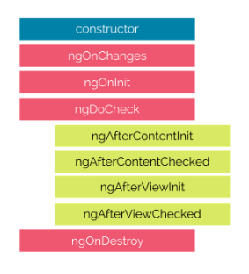
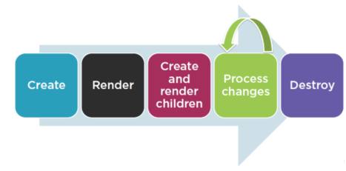
Life Cycle Hooks

Slide 9
Angular Material
Features
In-built responsive designing.
Standard CSS with minimal footprint.
Includes new versions of common user interface controls such as buttons, check boxes, and text fields which are adapted to follow Material Design concepts.
Includes enhanced and specialized features like cards, toolbar, speed dial, side nav, swipe, and so on.
Cross-browser, and can be used to create reusable web components.
Extensible
Angular Material is by design very minimal and flat.
It is designed considering the fact that it is much easier to add new CSS rules than to overwrite existing CSS rules.
It supports shadows and bold colors.
The colors and shades remain uniform across various platforms and devices

Slide 10
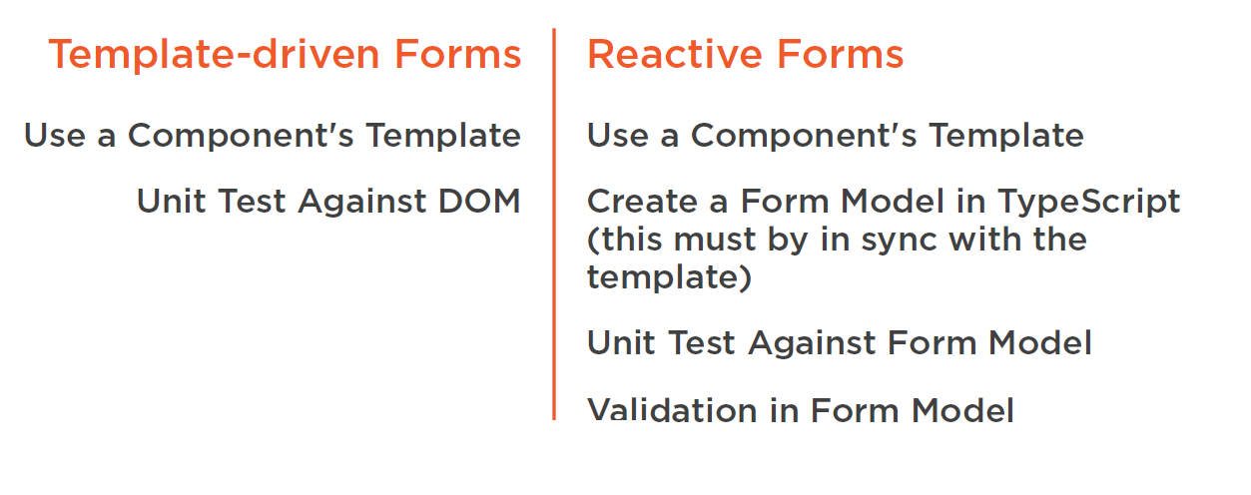
Forms

Slide 11
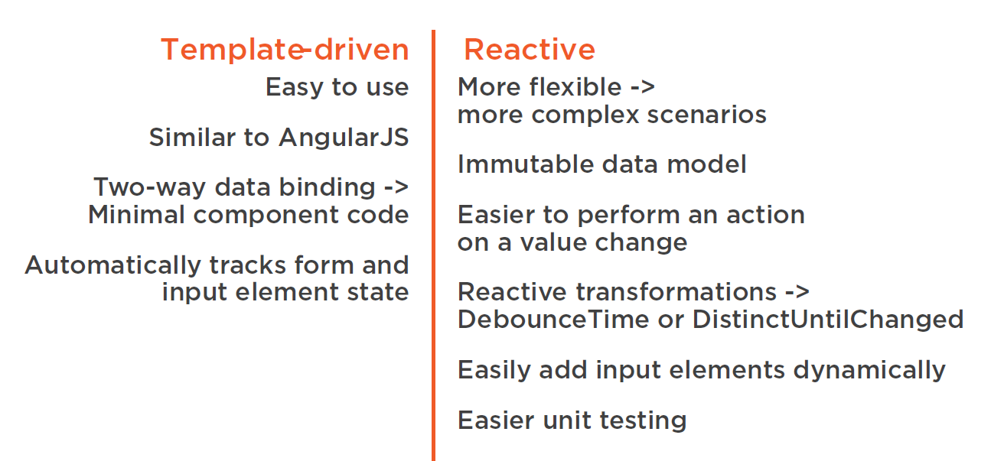
Forms

Slide 12
Data Binding in Forms
Using NgForm
<form #form=“ngForm”>
NgModel
Builds form.value
name attribute is required
Creating a Data Model
interface
Two-way Data Binding
[(ngModel)]=“variable”

Slide 13
HTML 5 Validation
required, pattern
minlength, maxlength, min, max

Slide 14
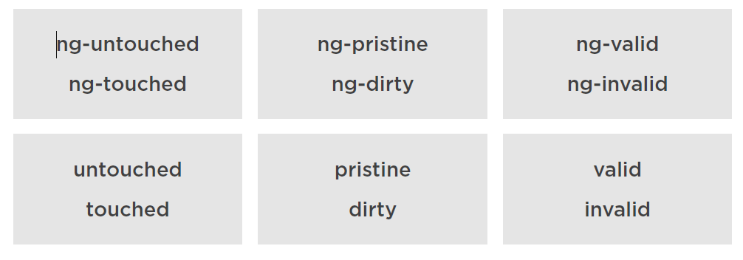
CSS Classes for Validation
Classes & Associated NgModel properties

Slide 15
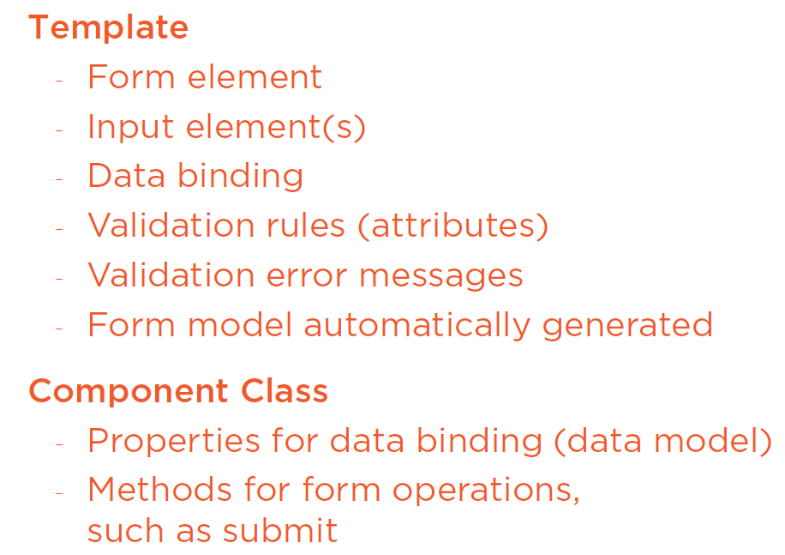
Template Driven Forms

Slide 16
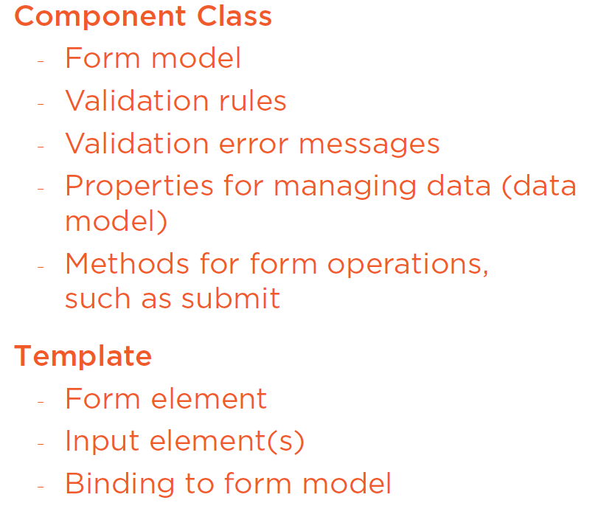
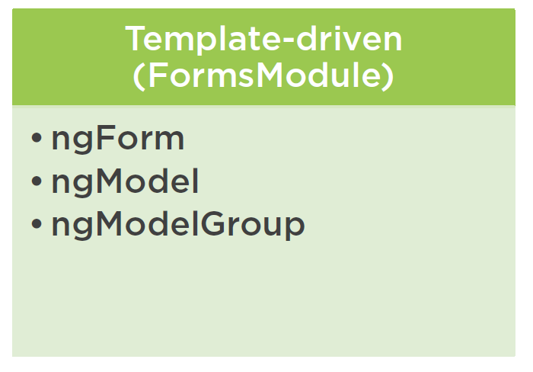
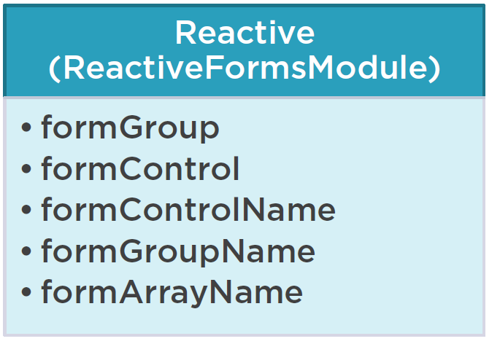
Reactive Forms

